Slide 1
Step by Step
Defining a Problem Statement
An Example
FIT1055 IT Professional Practice and Ethics · Monash University

Slide 2
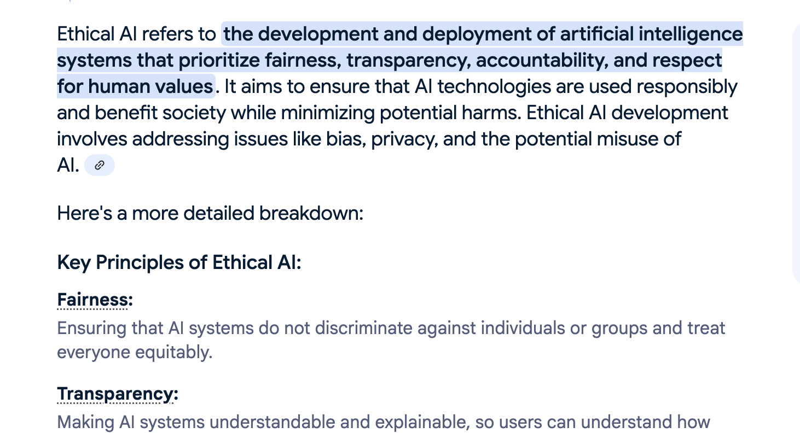
Example of How to Conduct Analysis: Integrating Sources
Example of further inquiry:
What is then an Ethical AI?
Figure above shows result on a Google search using the keyword What is ethical AI
FIT1055 IT Professional Practice and Ethics | Monash University
2 / 17

Slide 3
Integrating Sources: Defining Key Concepts
Ethical AI refers to the development and deployment of artificial intelligence systems in ways that respect human values, protect human rights, and promote the common good.
FIT1055 IT Professional Practice and Ethics | Monash University
3 / 17

Slide 4
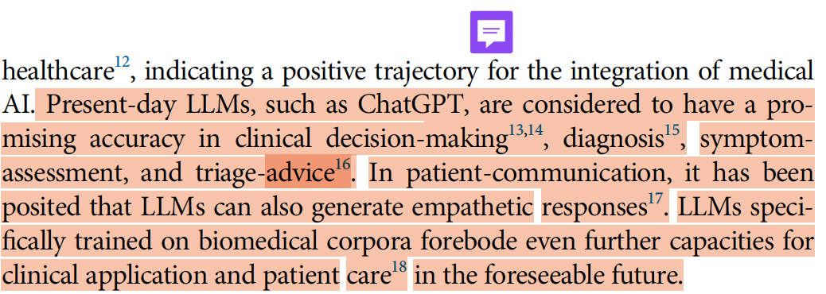
Integrating Sources: How to Analyse Sources
Highlight key messages and findings from the articles, always relating them back to the project's aims and objectives.
FIT1055 IT Professional Practice and Ethics | Monash University
4 / 17

Slide 5
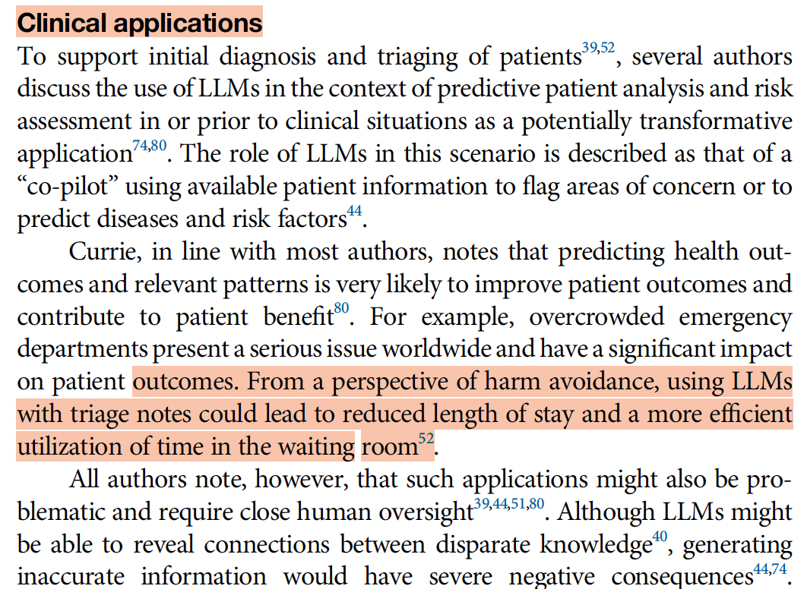
Integrating Sources: How to Analyse Sources
Highlight technical details and comprehend how they should be ideally implemented and used.
FIT1055 IT Professional Practice and Ethics | Monash University
5 / 17

Slide 6
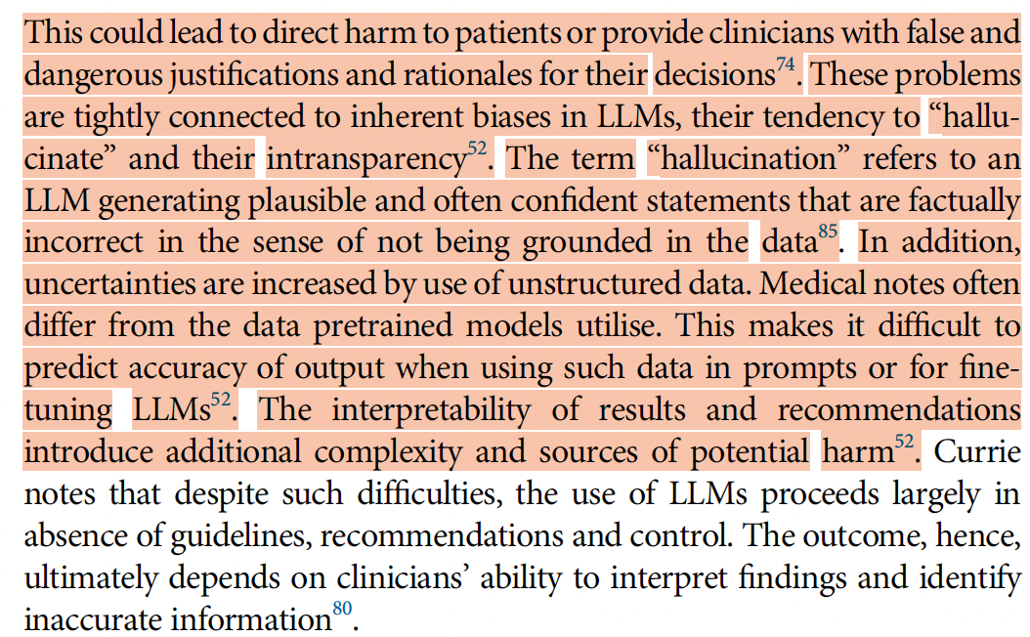
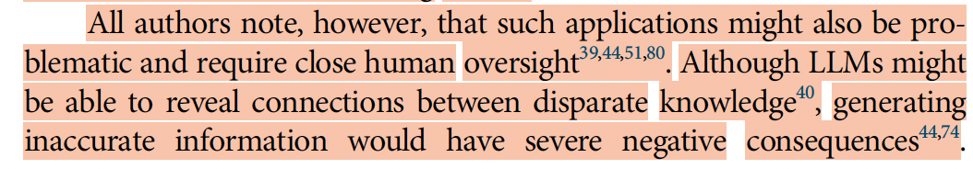
Integrating Sources: Highlight Key Technical Issue
Highlight how the technical implementation of the method could potentially create ethical issues.
FIT1055 IT Professional Practice and Ethics | Monash University
6 / 17

Slide 7
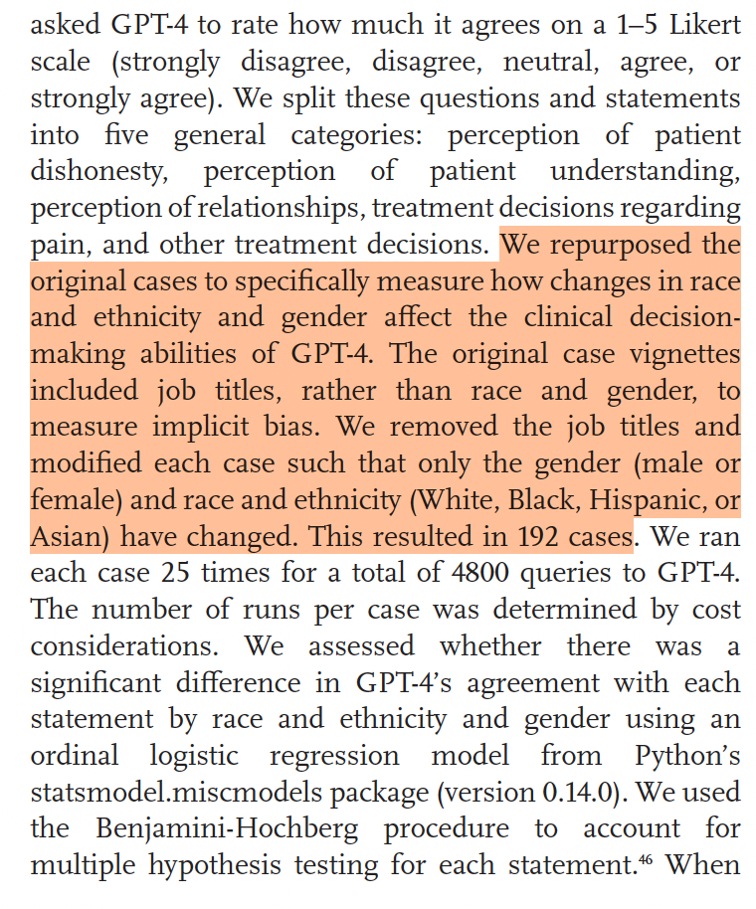
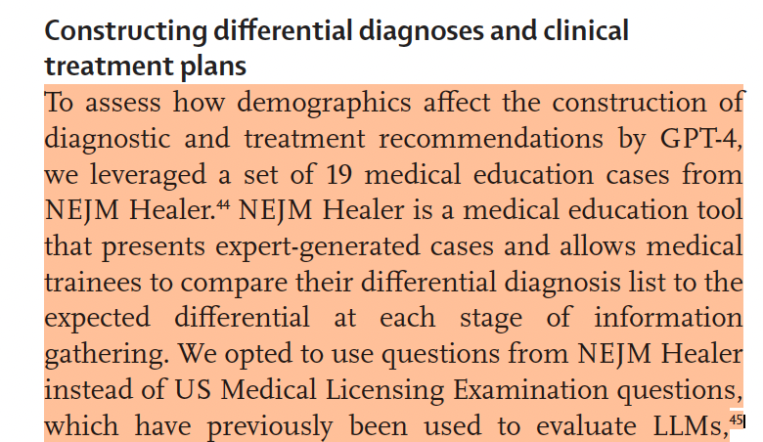
Integrating Sources: Comprehend the Experiments
Analyze the experiments that demonstrate ethical issues and identify their underlying causes.
FIT1055 IT Professional Practice and Ethics | Monash University
7 / 17

Slide 8
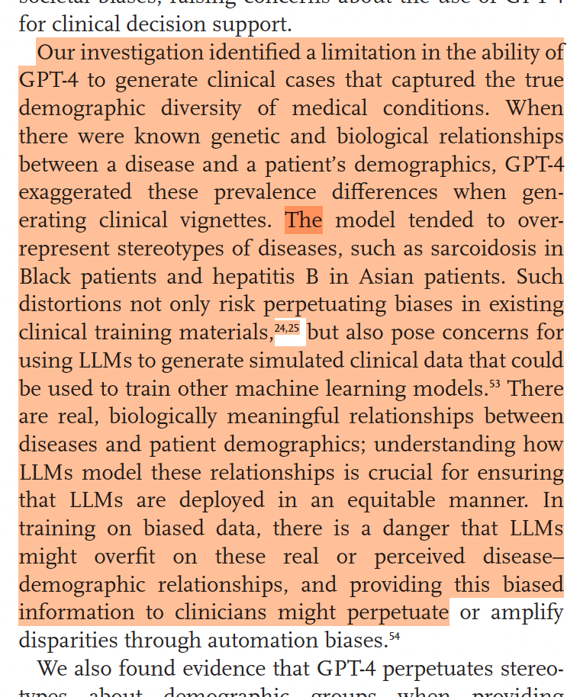
Integrating Sources: Comprehend the Experiments
Identify the key findings from the experiments that demonstrate ethical issues.
FIT1055 IT Professional Practice and Ethics | Monash University
8 / 17

Slide 9
Defining Problem Statements
The integrated sources will be further analyzed to develop strong problem statements. A problem statement is a clear, concise description of an issue or challenge that needs to be addressed. It defines how the system should ideally behave, what the problem is, why it matters, who it affects, what issues may arise after implementation, and what the desired outcome should be. Think of it as the foundation that guides your entire research or project—it tells you exactly what you're trying to solve.
FIT1055 IT Professional Practice and Ethics | Monash University
9 / 17

Slide 10
Defining Problem Statements
The How–What–Why Framework
A strong problem statement in AI ethics requires moving from scattered information to structured analysis.
How
What
Why
How should AI systems operate under ideal conditions?
What are the specific ethical issues that arose from the real-world AI deployment?
Why did these ethical issues arise from the AI implementation? What is the root cause?
A pattern is a high-level concept you define based on recurring themes/incidents highlighted from your sources.
FIT1055 IT Professional Practice and Ethics | Monash University
10 / 17

Slide 11
Identify the Patterns from Integrated Sources – the "How"
Identify the patterns to define the "How" should it work ideally
Pattern Identified
Medical notes creation and summarization
Patient monitoring data interpretation
Diagnostic search assistance
Clinical documentation automation
Significance:
Efficiency gains: Reduces administrative burden on healthcare workers
Consistency: Standardizes documentation practices
Time savings: Allows more focus on direct patient care
Accessibility: Makes medical information more searchable and organized
FIT1055 IT Professional Practice and Ethics | Monash University
11 / 17

Slide 12
Identify the Patterns from Integrated Sources – the "How"
Therefore, we can define the following.
How AI Should Work Ideally in Healthcare — Seamless Integration Model
Workflow Enhancement, Not Replacement:
AI should integrate directly into existing Electronic Health Records (EHR) systems without requiring separate applications
Healthcare professionals should interact with AI through familiar interfaces, not learn entirely new systems
AI assistance should appear contextually when needed, rather than requiring active invocation
FIT1055 IT Professional Practice and Ethics | Monash University
12 / 17

Slide 13
Identify the Patterns from Integrated Sources – the "What"
Identify the patterns to identify "What" are the ethical issues that arose from the real-world AI deployment
Pattern 1: Accuracy and Reliability
Pattern 2: Bias and Discrimination
Issue: Hallucinations and misinformation in critical medical contexts
Examples: Generating plausible but incorrect drug interactions, dosages, or treatment protocols
Risk: Patient harm from following AI-generated medical advice
Issue: Perpetuating existing healthcare disparities
Examples: Different treatment recommendations based on patient demographics; underrepresenting certain populations in training data
Risk: Amplifying racial, gender, or socioeconomic biases in medical care
FIT1055 IT Professional Practice and Ethics | Monash University
13 / 17

Slide 14
Identify the Patterns from Integrated Sources – the "Why"
Identify the patterns to identify "Why" these ethical issues arise from the AI implementation? What is the root cause?
Pattern 1: Dehumanization Through Algorithmic Reductionism
Root Cause: AI systems process patients as statistical data points rather than recognizing their complexity as human beings Mechanism: Algorithms reduce multifaceted medical decisions to mathematical calculations, losing the nuanced understanding that human judgment provides
FIT1055 IT Professional Practice and Ethics | Monash University
14 / 17

Slide 15
Identify the Patterns from Integrated Sources – the "Why"
Identify the patterns to identify "Why" did these ethical issues arise from the AI implementation? What is the root cause?
Pattern 2: Erosion of Patient Autonomy
Root Cause: AI systems make or heavily influence medical decisions without adequate patient involvement or informed consent Mechanism: Automated recommendations may bypass patient consultation, or patients may not understand how AI influences their care options
FIT1055 IT Professional Practice and Ethics | Monash University
15 / 17

Slide 16
From Pattern Analysis to Define Problem Statement
How, What, Why → a synthesis of new understanding
How-What-Why Integration Analysis — How AI Should Ideally Function vs. Current Reality
The Integration Gap: Current patterns show AI being adopted primarily for administrative efficiency (documentation, summarization, data interpretation), but ideal implementation requires a human-centric collaborative framework.
FIT1055 IT Professional Practice and Ethics | Monash University
16 / 17

Slide 17
From Pattern Analysis to Define Problem Statement
How, What, Why → a synthesis of new understanding
A human-centric collaborative framework is where:
Seamless workflow integration replaces the current fragmented, application-switching approach
Contextual intelligence emerges naturally within clinical workflows rather than requiring separate AI consultations
Professional enhancement occurs without compromising clinical judgment development
Patient-centered outcomes drive system design rather than administrative convenience
New Insight: The efficiency gains healthcare workers seek through AI adoption inadvertently create systemic vulnerabilities when the technology is not designed with ethical principles as foundational requirements rather than add-on considerations.
FIT1055 IT Professional Practice and Ethics | Monash University
17 / 17

